Slide 1
NIELIT PROJECT 2024
Project name: Simple Registration Form using Tkinter in Python
Prepared by : Tiyasa Mukherjee
Submitted To: Mr. Kailash Joshi

Slide 2
Abstract
Objective: The project aims to create a simple and user-friendly registration form using the Tkinter library in VS Code(Python), focusing on collecting essential user information such as first name, last name, email, and password.
Implementation: The form is developed with a graphical user interface (GUI) that includes form fields for user data entry and a submit button to handle form submission and validation.
Validation and Feedback: The project incorporates basic validation to ensure all fields are filled before submission, providing immediate feedback to users through message boxes indicating success or errors.
Learning Outcomes: This project demonstrates practical application of Python programming and GUI development, reinforcing concepts learned during the “Data Analytics using Python” course.
Future Enhancements: The project lays the groundwork for further development, such as integrating with databases for data storage, adding more complex validation rules, and enhancing the user interface for improved user experience.

Slide 3
Project Objectives
Create a User-Friendly Interface: Develop a simple and intuitive graphical user interface (GUI) for a registration form using the Tkinter library in VS Code.
Collect User Data: Design the form to capture essential user information such as first name, last name, email, and password.
Implement Form Validation: Ensure that all required fields are completed before allowing the user to submit the form, providing feedback on any missing information.
Provide User Feedback: Utilize message boxes to inform users of the successful submission of their registration or any errors that need to be addressed.
Lay Foundation for Future Enhancements: Create a basic yet functional registration form that can be expanded with additional features, such as database integration or more advanced validation rules, in future iterations.

Slide 4
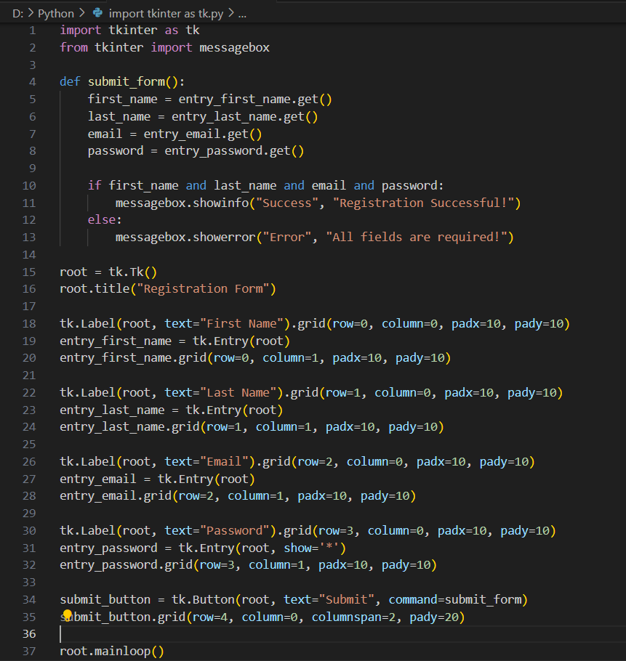
Code Implementation
The Python code below demonstrates how to create a registration form using Tkinter. It includes fields for first name, last name, email, and password, with a submit button to handle the form submission.

Slide 5
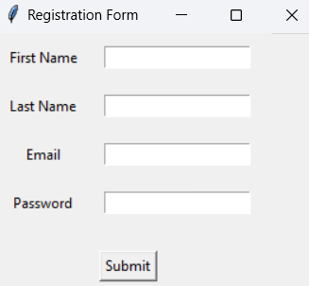
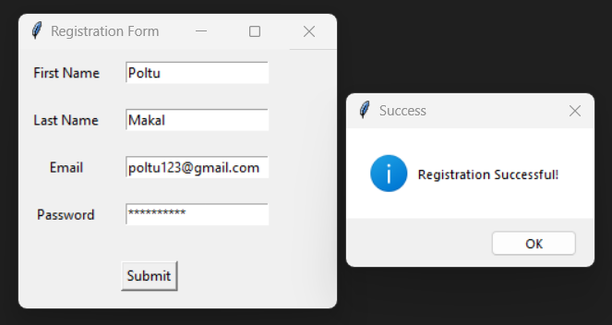
User Interface
Initial Interface: The initial interface presents empty fields for the user to input their information, along with a submit button.
Filled Form: The initial interface presents empty fields for the user to input their information, along with a submit button.

Slide 6
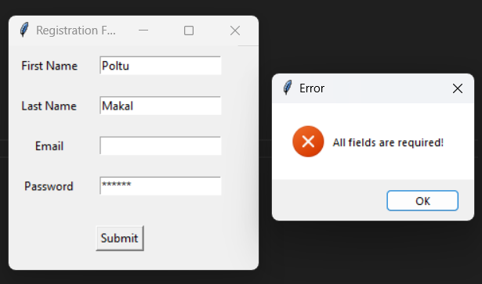

Result and Success Message
Functionality:
The submit_form function collects the entered data and checks if all fields are filled.
If all fields are filled, a success message is displayed using messagebox.showinfo.
If any field is empty, an error message is shown using messagebox.showerror.
Success Message Display:
A pop-up message box confirms the successful registration when the form is correctly filled and submitted.

Slide 7
Conclusion
Key Takeaways:
Tkinter is a powerful tool for creating simple GUI applications in Python.
The form validation ensures that all required fields are completed before submission.
Message boxes provide immediate feedback to users on the status of their submission.
Next Steps:
Enhance the form with additional fields or validation rules.
Integrate the form with a database to store user registration details.
Customize the UI for a better user experience.

Slide 8
THANK YOU

